Slide 2
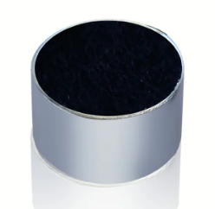

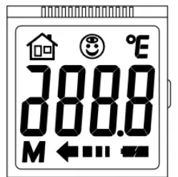



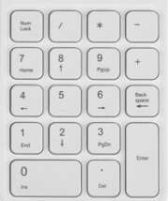
SNC8600 对讲机系统框图
SNC8600
RF
IIS
AMic1
Alg
Switch
AMic2
DAC
Display Driver
Uart/IIC
GPIO * 2
IIC
ADC1
Charge IC
ADC2
GPIO * 9
Battery

